Slide 1
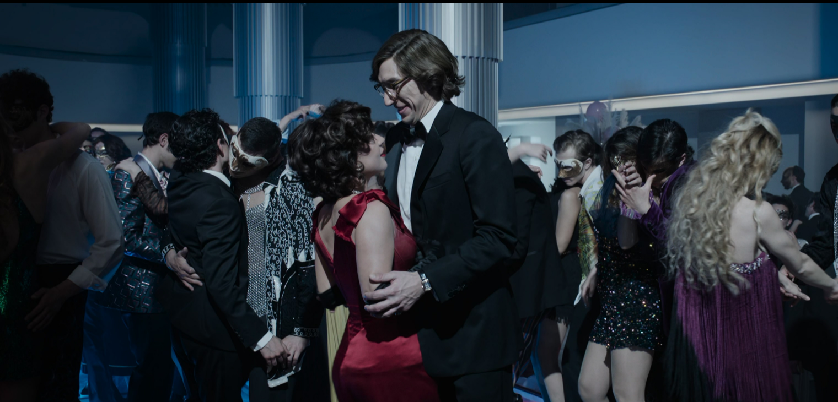
abc1 adults

Slide 2
ABC1 ADULTS MEDIA CONSUMPTION: A SUMMARY
Following the digital uplift post-pandemic, ABC1s are spending more time wanting to feel connected with others
72%
of ABC1 adults are cinemagoers
76%
pay for a subscription VOD service
5% uplift from non-cinemagoers
16 hours
Of live TV viewed per week.
2 hours less than the avg. UK adult
60%
buy a product or service on their mobile at least once a month
TGI GB 2022. Target: ABC1 adults who are cinemagoers. Index vs Average UK adult

Slide 3
AFFLUENT adults SPENDING BEHAVIOUR
ABC1 cinemagoers enjoy spending money on entertainment and shared moments with friends/family
63%
get a takeaway/food delivery at least once a month¹
51% agree that they like to try new drinks
5% uplift from non-cinemagoers²
ABC1 CINEMAGOERS
59%
Go to a live music concert/gig or theatre at least once a year¹
26%
more likely than the avg. UK adult book a holiday once every 3 months¹
64%
More likely to own a hybrid car than the avg. UK adult¹
42%
more likely than the avg. UK adult to go to a pub or bar at least once a month¹
Source: 1 IPA Touchpoints 2021. Target: ABC1 adults who have visited the cinema in the past 12 months. Index vs the average UK adult
2 TGI GB 2022. Target: ABC1 adults who are cinemagoers. Index vs ABC1 non-cinemagoers

Slide 4
Just under 60% agree that the cinema is a great way to spend quality time with friends & family
Source: FAME 2021. Target: ABC1 cinemagoers.

Slide 5
ABC1s want to see the latest blockbusters first
Young adults come out early and make up the majority of the audience in a blockbuster's opening week.
% of the viewing audience that are ABC1s
ABC1s account for 54% of the population
Source: FAME 2021. Target ABC1s. How Long After the Cinema Release Date Did You See The Film?
Film Monitor Data 2022 W2
Notes:
So we can infer that even though men will be prioritising the world cup, they are also more likely to watch new releases in the first two weeks and with the plethora of films we have coming out at the end of the year, brands will be able to access them in the right way.

Slide 6
ABC1’s feel more positive watching films
They tend to feel more attentive, engaged and relaxed in a cinematic setting which can fundamentally help drive trust with your adverts
Frame of mind when watching…
Source: FAME 2021. Target: ABC1 cinemagoers. Index vs all adults

Slide 7
Your advertising can ALSO have instant impact
98% OF DCM CINEMAS ARE WITHIN ONE MILE OF A RETAIL LOCATION
Cinema is typically part of a wider trip, so you can reach mainshoppers before they go to a shop either online or in-store
After watching a film, heavy cinemagoers are more likely to…
Source: FAME 2021. Activities do immediately after / on same day as cinema visit. Target: ABC1 mainshoppers who are heavy cinemagoers. Index vs. average GB adult
Notes:
So we can infer that even though men will be prioritising the world cup, they are also more likely to watch new releases in the first two weeks and with the plethora of films we have coming out at the end of the year, brands will be able to access them in the right way.

Slide 8
KEY LAUNCH OPPORTUNITIES FOR ABC1 ADULTS
The film slate is full of highly-anticipated releases that will draw in an affluent adult audience
Amsterdam
7 Oct 2022
Index 159
Avatar: The Way Of Water
16 Dec 2022
Index: 131
The Fabelmans
27 Jan 2023
Index 143
Empire Of Light
13 Jan 2023
Index 169
Index vs. % of ABC1 adult in UK population.
Based on comparative film profiles.

Slide 9
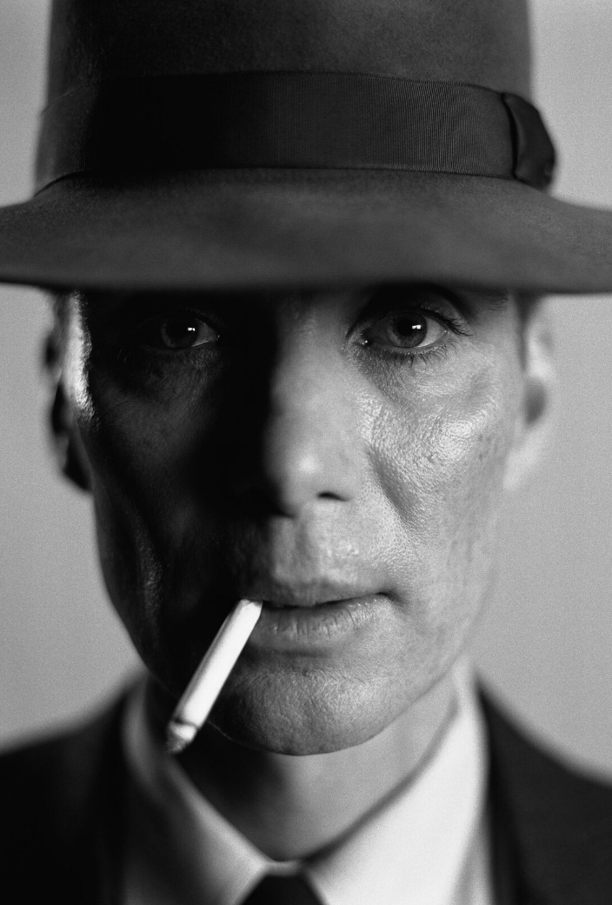
KEY LAUNCH OPPORTUNITIES FOR ABC1 ADULTS
The film slate is full of highly-anticipated releases that will draw in an affluent adult audience
Kraven the Hunter
13 Jan 2023
Index 124
Babylon
20 Jan 2023
Index 143
Aquaman 2
26 Dec 2023
Index: 114
Oppenheimer
21 July 2023
Index 140
Index vs. % of ABC1 adult in UK population.
Based on comparative film profiles.

Slide 10
What can Cinema add to your ABC1 ADS media plan?
Cinema allows you to engage an audience when they’re in a positive and receptive mindset and most willing to pay attention to ads.
Positive mood
Receptive to ads
Pay more attention to ads
71% of ABC1 Adults report in the IPA TouchPoints survey that they’re in an above average mood while visiting the cinema
Kantar’s ‘Media Reactions’ report found that consumers have a positive perception of the ads they see in cinemas – with the big screen ranking top of all channels for ‘brand equity’.
DCM’s Launch, Land, Impact research found that 56% of ABC1 Adults agree that they ‘pay more attention to ads in cinema than elsewhere’
Sources: IPA TouchPoints 2021 , Kantar Ad Reaction & DCM/Differentology (1,000 ABC1 Adults

Slide 11
Cinema DELIVERS POSITIVE OUTCOMES FOR BRANDS
Cinema has been shown to deliver significant uplifts on key brand metrics
Meta-analysis of 35 cinema campaigns
+24%
+17%
+11%
+24%
+19%
Ad Awareness | Relevance | Trust* | Brand Impression | Consideration
Source: Differentology, databank of 35 cinema campaign effectiveness studies
Relevance = ‘Brand X is for people like me’. *Trust uplift based on 5 campaigns from finance/tech/telecoms/travel sector. Impression = ‘better impression of brand’ as a result of campaign

Slide 12
ABC1 ADULT HEAVY CINEMAGOERS: 2022 SNAPSHOT
Heavy cinemagoing ABC1 adults are more likely to be planning big purchases…
136
Plan to renovate part of home
115
Buy new car
141
Buy new smart household device
113
Go on holiday abroad
122
Buy luxury beauty products/treatments
133
Buy luxury clothes and accessories
171
Buy smart tech for the home
130
To buy alcoholic drinks whilst visiting the cinema
Source: TGI 2022
Target: ABC1 Heavy cinemagoers. Index vs. average GB ABC1 adult.

