Slide 1
The 16-34 audience
How brands can reach a young adult audience through cinema

Slide 2
Young adults are more affluent CONSUMERS
16-34s are using subscription services to create their own entertainment viewing schedules and therefore are becoming harder to reach & engage on linear – but cinema retains its appeal.
Demographics
A highly affluent audience
Lifestyle
Culture-centric and quality-driven
Media habits
More fragmented media consumption
 | Non-cinemagoing 16-34s | Cinemagoing 16-34s
ABC1 | 53% | 63%
£50k+ HH income | 17% | 22%
Children in HH | 42% | 46%
‘I love anything new’ (Index: 140)
‘It’s worth paying extra for quality goods’ (60% agree, Idx: 102)
‘I am interested in the arts’ (Index: 120)
Source: GB TGI Dec 2024. 16-34 cinemagoers. Index vs. avg. GB adult

Slide 3
78% OF 16-34S
ARE CINEMAGOERS
Source: TGI GB Dec 2024
Notes:
Statements or numbers on this slide should be short and concise

Slide 4
In the ERA OF ‘social media’, people are spending more time ALONE
But cinema is there to relieve the disconnection in society, being a large part of people's community & cultural life, helping them feel less alienated from eachother.
Mean hours per day spent alone
“I feel distant from other people”
(60% agree)
“There is no sense of community anymore”
(56% agree)
Time spent alone since 2014 has increased by:
+47%
“Cinema helps people feel less isolated and cut-off”
(63% agree)
“Cinema helps bring the community together”
(55% agree)
Source: IPA TouchPoints 2014-2023. DCM/Burst Your Bubble 2024
Base: 16-34 (n=479).

Slide 5
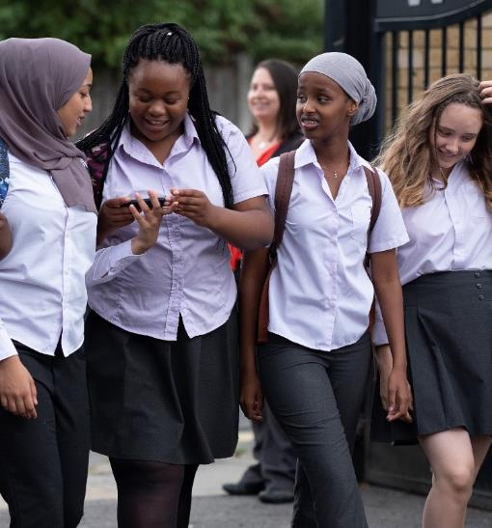
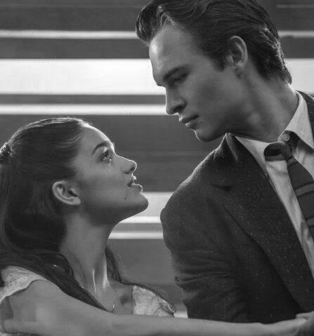
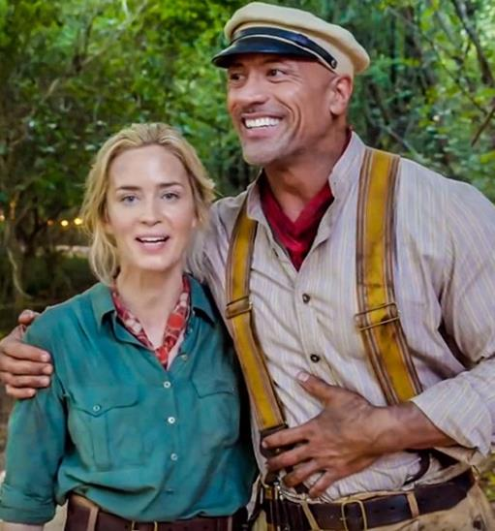
Cinema ads are the advertising format 16-34s are most RECEPTIVE towards
Independent research from Kantar found that traditional AV ad formats are preferred by all generations but specifically cinema rates well amongst young audiences – making it the best place to start your campaigns with a positive impression.
Gen Z
16-19 year olds
Gen Y
20-34 year olds
Gen X
35-49 year olds
Cinema ads | 44% | 34% | 31%
TV ads | 14% | 23% | 33%
Video ads (laptop/PC) | -24% | -20% | -33%
Video ads (mobile) | -26% | -26% | -33%
Source: Kantar – AdReaction Study
‘How would you describe your attitude towards each of the following formats of advertising? - % net positive ’

Slide 6
Young adults want to see the latest blockbusters first
16-34s come out early and make up the majority of the audience in a blockbuster's opening week, in addition to making up the most of films overall audience even longer than a month after it’s release.
“I Feel Left Out If My Friends Are Talking About A Film I Have Not Seen”
(Index: 113)
“A Lot Of My Friends Ask My Advice About Films”
(Index: 110)
Visit The Cinema With 5 Or More People
(Index: 140)
31% of population are aged 16-34
Notes:
And whilst being the most sociable, cinema also provides the most culturally relevant content, where 16-34s come out early and make up the majority of the audience in a blockbuster's opening week
And just looking at the overall sample, if we cut the data by those who pay for 5 or more streaming services, they are 21% more likely than the avg. adult to watch a film on its opening weekend and those who went with 5+ other people, likely a big group of friends or a large family, they are 52% more likely than the avg. GB adult to watch a film on its opening weekend.
So why do young adults, those with more streaming services and those that go in large groups, tend to watch a film on its opening weekend?

Slide 7
THE CULTURAL RELEVANCE OF CINEMA
16-34s are an audience who hotly anticipate content and don’t want to miss out on anything, in addition to being passionate about the quality of content they watch.
TRENDS & STYLES
INFLUENCERS
CULTURE CENTRIC
EARLY ADOPTERS
“Movies give me ideas about style, fashion and music”
(48% agree, Index: 112)
“A lot of my friends ask my advice about films”
(42% agree, Index: 116)
“I love the hype around big film releases at the cinema”
(57% agree, Index: 103)
“I love new products & tech, and I am always the first to try them”
(25% agree, Index: 138)
Source: FAME 2023. Target: 16-34. Index v avg. GB adult

Slide 8
THE young adult AUDIENCE
Early adopters, travel lovers & passionate about their home.
I am interested in responsible financial products which have a positive impact on society
(Index: 126)
‘I buy new products before most of my friends’
(Index: 176)
‘I love to buy new gadgets and appliances’
(Index: 143)
‘I change the décor of my home as often as I can’
(Index: 175)
‘I'm always looking for new ideas to improve my home’
(Index: 135)
2x more likely to intend to purchase a games console
34% more likely to plan to renew their mortgage in the next 12 months
‘I am passionate about travelling’
(Index: 123)
Source: TGI Dec 2024
Target: 16-34 cinemagoers. Index vs. average GB adult.
Notes:
Statements or numbers on this slide should be short and concise

Slide 9
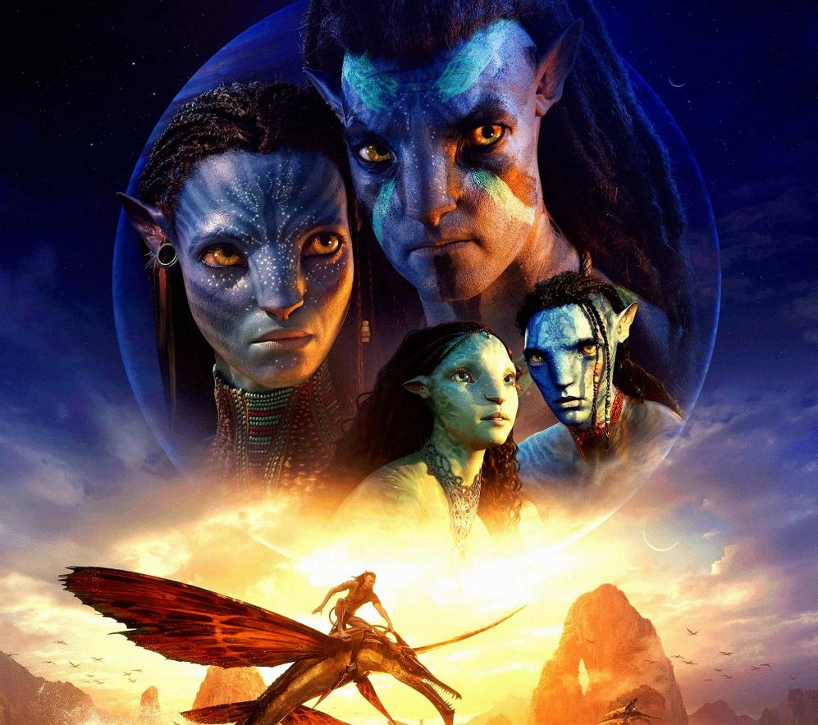
2025 top 10 16-34 BLOCKBUSTER forecasts
These will be the big hitters for reaching young ads on cinema across 2025…
 | Industry Admissions | 16-34 TVRs
Avatar: Fire And Ash December | 6.0m | 18
Wicked Part II November | 6.1m | 11
Jurassic World Rebirth July | 3.8m | 11
Bridget Jones: Mad About The Boy February | 4.2m | 11
Michael October | 3.6m | 8
The Fantastic Four: First Steps July | 2.4m | 8
Zootropolis 2 November | 3.0m | 8
Minecraft April | 3.0m | 7
Disney's Snow White March | 2.6m | 7
F1 June | 3.0m | 7
Source: DCM. Based on industry admissions forecasts and comparative film profiles

Slide 10
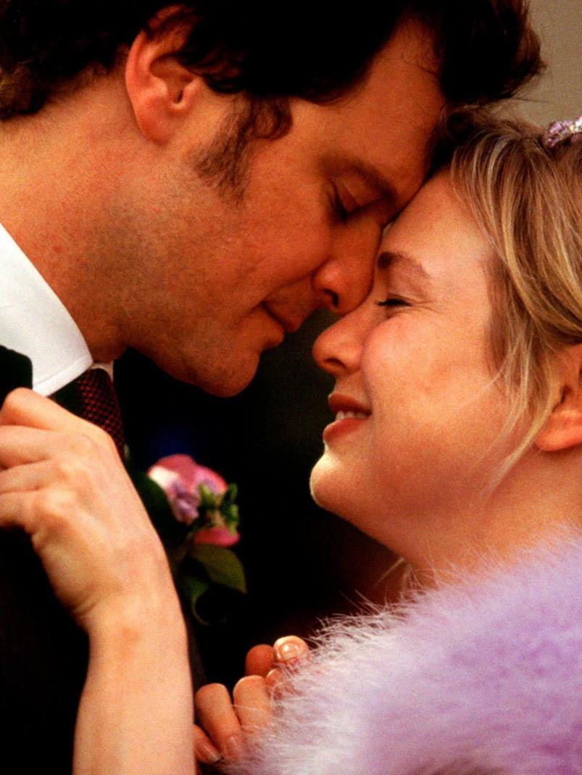
Bridget jones: MAD ABOUT THE BOY
The fourth in the series of one of the greatest British romantic comedies
RELEASE DATE | EST. INDUSTRY ADMISSIONS | GENRE | HFSS BRANDS | ALCOHOL/GAMBLING BRANDS
14 Feb 2025 | 4.3m | Romantic comedy | Yes | Yes
SYNOPSIS
Bridget Jones: Mad About the Boy is an upcoming romantic comedy film that returns us to the life of one of the most iconic British comic creations
CAST
Renée Zellweger, Emma Thompson, Hugh Grant, Leo Woodall
THE DCM TAKE
Nearly a decade has passed since we last encountered our endearingly chaotic heroine, Bridget Jones, in all her dishevelled charm. Bridget Jones is poised to return to the screen in Mad About The Boy, which is the fourth instalment in the Bridget Jones' Diary franchise. This film is expected to draw from Helen Fielding's 2013 novel and it’s believed that the film will focus on Jones' pivot to online dating and her dalliance with a suitor 28 years her junior, who will be played by Leo Woodall (The White Lotus, One Day).
Scheduled to release on Valentine's Day 2025, this film presents an excellent opportunity for travel, food, and retail brands, strategically timed to maximise reach towards ABC1 Women.
 | Adults (16+) | 16-34 Ads | Female Houseperson with Children | 16-34 Women | ABC1 Women
REACH | 7.9% | 10% | 12.2% | 16.8% | 17.1%
IMPACTS | 4.2m | 1.6m | 1.2m | 1.3m | 2.5m
TVRS | 8.7 | 10.8 | 13 | 18 | 19
Source: DCM, based on forecast industry admissions and comparative film profile

Slide 11
SNOW WHITE
Nostalgic live-action remake featuring the beloved Disney princess
RELEASE DATE | EST. INDUSTRY ADMISSIONS | GENRE | HFSS BRANDS | ALCOHOL/GAMBLING BRANDS
21 March 2025 | 2.6m | Musical, Adventure, Drama | Yes | No
SYNOPSIS
Live-action adaptation of the 1937 Disney animated film Snow White and the Seven Dwarfs which will be made much more in line with modern sensibilities. Snow White will no longer be a helpless damsel in distress needing to be saved by a handsome prince's kiss. In fact, she will go to battle alongside Jonathan, her love interest in the movie.
CAST
Rachel Zegler, Gal Gadot, Andrew Burnap, Ansu Kabia
THE DCM TAKE
Disney’s live-action remakes have consistently attracted a young adult audience, driven by nostalgia and creating a buzz that continues to appeal. The latest live-action release from Disney The Little Mermaid performed strongly at the UK box office, grossing £27.4m and garnering worldwide acclaim. As the first ever full-length animated film, Snow White and the Seven Dwarfs (1937) holds a special place not only in the history of Disney but in the evolution of cinema itself. In this latest adaptation, Snow White will be played by rising star Rachel Zegler, who is best known for her role in the recent remake of West Side Story (2021) for which she won the Golden Globe Award for Best Actress and The Hunger Games: Ballad of Songbirds and Snakes (2023). Attracting a predominantly young adult audience, this will be the perfect fit for personal care and FMCG brands looking to reach this demo and families across the Easter period.
 | Adults (16+) | HP+CH | 16-34 Adults | 16-34 Women | ABC1 Adults
REACH | 4% | 4% | 6% | 8% | 4%
IMPACTS | 1.9m | 682k | 1m | 728k | 1.1m
TVRS | 4 | 5 | 7 | 10 | 4
Based on industry admissions and comparative film profile

Slide 12
MINECRAFT
Be there or be square!
RELEASE DATE | EST. INDUSTRY ADMISSIONS | GENRE | HFSS BRANDS | ALCOHOL/GAMBLING BRANDS
4 April 2025 | 3m | Adventure / Comedy | Yes | No
SYNOPSIS
A mysterious portal pulls four misfits into the Overworld, a bizarre, cubic wonderland that thrives on imagination. To get back home, they'll have to master the terrain while embarking on a magical quest with an unexpected crafter named Steve.
CAST
Jason Momoa, Jack Black, Emma Myers, Danielle Brooks, Jennifer Coolidge
THE DCM TAKE
Since its first teaser trailer release, Minecraft has drawn significant attention from fans on social media, eager to see how the game's blocky visuals and open-world charm will translate to the big screen. With it’s cast including popular actors like Jason Momoa and Jack Black involved, the film is expected to blend humour with the game’s pixelated charm, using CGI to bring its unique visuals to life. As video game adaptations rise in popularity, films like The Super Mario Bros. Movie (2023), Sonic the Hedgehog (2020), and Five Nights at Freddy’s (2023) have paved the way for Minecraft's fresh take on the genre.
Strategically timed to release before the Easter school holidays, Minecraft will be an efficient way for brands to reach younger audiences and families.
 | Adults (16+) | HP+CH | 16-34 Adults | 16-34 Men | Children 7-15
REACH | 4% | 6% | 7% | 7% | 11%
IMPACTS | 2.2m | 1m | 1m | 608k | 766k
TVRS | 5 | 7 | 7 | 8 | 12
Source: Based on industry admissions and comparative film profile

Slide 13
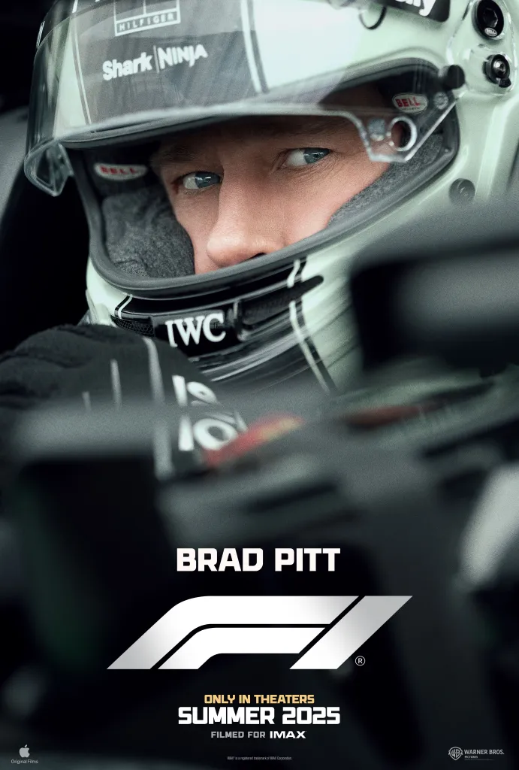
F1
It’s lights out, and away we go!
RELEASE DATE | EST. INDUSTRY ADMISSIONS | GENRE | HFSS BRANDS | ALCOHOL/GAMBLING BRANDS
27 June 2025 | 3m | Sport/Action | Yes | Yes
SYNOPSIS
A former driver finds himself back in action when he returns to Formula 1 racing to take on the sport's top competition.
CAST
Brad Pitt, Damson Idris, Kerry Condon, Tobias Menzies, Javier Bardem, Sarah Niles
THE DCM TAKE
Coming from the same director as Top Gun: Maverick, the highest-grossing film of 2022 and the 13th most successful film of all time worldwide, F1 is anticipated to have a similar feel both in its thrilling action sequences and overall cinematic impact, attracting cinephiles and F1 fans alike. Recognising the value of a cinematic event to fully capture the film's scale and appeal, Warner Bros. acquired the theatrical distribution rights from Apple, ensuring the film receives the high-profile, big-screen release it deserves before it eventually becomes available on Apple TV+, mirroring what we have seen in the past with successful films like Killers of the Flower Moon (2023). Made in collaboration with Formula 1 and the F1 community, the film is expected to be exhilarating, immersive and true to the sport, making it likely to resonate strongly with a young male audience - an ideal fit for sports, active & leisure brands.
We've already seen significant interest, with the Gold Spot already secured…
 | Adults 16+ | 16-34 Adults | 16-34 Men | ABC1 Adults | ABC1 Men
REACH | 5.2% | 6.0% | 8.2% | 6.5% | 8.3%
IMPACTS | 2.7m | 997k | 695k | 1.9m | 1.2m
TVRs | 5.6 | 6.5 | 8.9 | 7.2 | 9.3
Source: DCM, based on forecast industry admissions and comparative film profile

Slide 14
superman
A reboot of the most iconic superhero
RELEASE DATE | EST. INDUSTRY ADMS | GENRE | HFSS BRANDS | ALCOHOL/GAMBLING BRANDS
11 July 2025 | 2.4m | Action / Adventure | Yes | No
SYNOPSIS
Superman embarks on a journey to reconcile his Kryptonian heritage with his human upbringing as Clark Kent.
CAST
David Corenswet, Rachel Brosnahan, Nicholas Hoult, Edi Gathegi, Anthony Carrigan, Nathan Fillion
THE DCM TAKE
Early last year, the DC Universe (DCU) announced a bold new strategy, describing it as a ‘broad but not blanket reset’ of the previous DC Extended Universe (DCEU). This ambitious direction involves a 10-year plan, structured into multiple chapters of interconnected storytelling with the first chapter, titled Gods and Monsters, kicking off with Superman. The teaser trailer shattered records, reaching over 250 million views within its first 24 hours, holding the title of the most-viewed trailer in the history of both DC and Warner Bros. The trailer shows the first glimpse of David Corenswet as the new Man of Steel, Nicholas Hoult as Lex Luthor and teased appearances of other characters set to populate this reimagined story. Releasing in summer of 2025, Superman will be an efficient way for brands to reach young males during a time there are no major sporting events on.
 | Adults (16+) | 16-34 Adults | 16-34 Men | ABC1 Adults | ABC1 Men
REACH | 3.9% | 5.6% | 7.3% | 4.7% | 6.8%
IMPACTS | 2m | 910k | 610k | 1.3m | 968k
TVRS | 5 | 6 | 8 | 5 | 7
Source: Based on industry admissions and comparative film profile

Slide 15
The Fantastic Four: First Steps
The first film to kick off MCU Phase 6
RELEASE DATE | EST. INDUSTRY ADMISSIONS | GENRE | HFSS BRANDS | ALCOHOL/GAMBLING BRANDS
25 July 2025 | 2.4m | Superhero/Action | Yes | No
SYNOPSIS
A mysterious portal pulls four misfits into the Overworld, a bizarre, cubic wonderland that thrives on imagination. To get back home, they'll have to master the terrain while embarking on a magical quest with an unexpected crafter named Steve.
CAST
Pedro Pascal, Vanessa Kirby, Joseph Quinn, Ebon Moss-Bachrach
THE DCM TAKE
The Fantastic Four: First Steps kicks off Phase 6 of the MCU, providing a fresh new take on the familiar narrative, with the original film releasing exactly 20 years ago. Featuring a star-studded cast, this film offers a fresher, more upmarket tone compared to many previous MCU films. It was revealed earlier this year that the film would be a period piece set in the 1960s within an alternate universe, giving it more of an authentic and refreshing aesthetic that is likely to attract a wider range of audiences. Despite it differing from other MCU films, it was confirmed at the San Diego Comic-Con in July 2024, that the cast would reprise their roles in Avengers: Doomsday (2026) and Avengers: Secret Wars (2027), starring alongside Robert Downey Jr. as Dr. Doom, emphasising the significance of The Fantastic Four: First Steps within the MCU timeline.
 | Adults (16+) | ABC1 Adults | 16-34 Adults | 16-34 Men
REACH | 4% | 5% | 8% | 10%
IMPACTS | 2m | 1.3m | 1.2m | 825k
TVRS | 4 | 5 | 8 | 11
Source: Based on industry admissions and comparative film profile

Slide 16
Tv and cinema are the strongest channels when it comes to strength signalling
High quality, shared experiences, regulated content and perceived higher entry costs to advertising help TV and Cinema deliver ‘strength signals’ for brands advertising in each channel, both for All Ads and 16-34s.
Source: EssenceMediacom & Burst Your Bubble

Slide 17
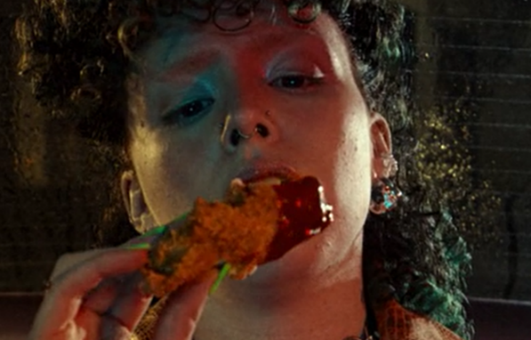
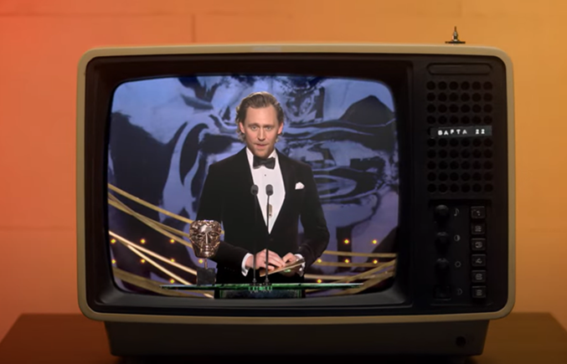
Cinema DELIVERS POSITIVE OUTCOMES FOR targeting 16-34s
Looking at our brand lift study databank, it’s evident that cinema drives significant uplifts for your key brands metrics across the full funnel.
Meta-analysis of 27 cinema campaigns: Average uplifts seen from Control (unexposed to cinema ad) vs Test (exposed to cinema ad)
+49%
Recall
+24%
Birds Eye
KFC wanted to stand out in the industry against their competitors as the number one place to get great tasting chicken amongst their target audience of young adults.
Knowing that cinema would be beneficial to help launch this creative, KFC bought into an HFSS AGP in addition to several film packs from running from 12th June - 3rd September.
Overall, KFC benefitted from accessing the premium and engaging environment of cinema that was successful in delivering significant uplifts across KFCs core metrics including: +15% uplift in association with being diverse and inclusive and +159% uplift in extremely likely to consider KFC for young adults
BAFTA and DCM partnered on a cinema campaign designed to promote a new message to inspire and ignite the next generation of creative talent, targeting 16-34s.
The ‘Behind Every BAFTA’ ad, produced by DCM Studios and narrated by double BAFTA-award winning Big Zuu, showcased the diverse range of skills and knowledge that goes into making award-winning films, games and television.
Overall, the results highlight how promoting a new message in the high attention environment of cinema can deliver key campaign KPIs, with 42% considering a career in the screen industries and those who were exposed to the ad in the cinema saw a +32% uplift in having a ‘much better impression of BAFTA’.
Perceptions
+38%
Recommendation
Source: Differentology Cinema Effectiveness Databank (2016 – 2024). Meta-analysis consists of 27 cinema campaigns that all targeted HP+CH Uplifts based on relative difference between Control (unexposed to ad) vs Test (exposed to ad). Results for all respondents

Slide 18
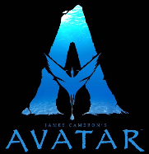
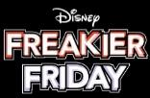
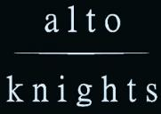
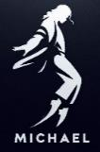
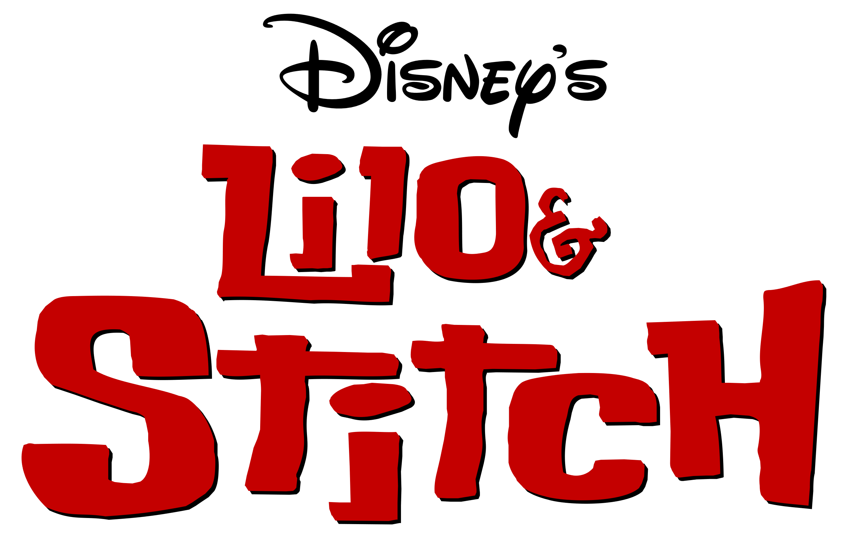
FILM SLATE 2025
TRON
ARES
Insidious (Sequel)
VICIOUS
JAN
Feb
Mar
APR
MAY
JUN
JUL
AUG
SEPT
OCT
NOV
DEC
28 Years Later

