Slide 1
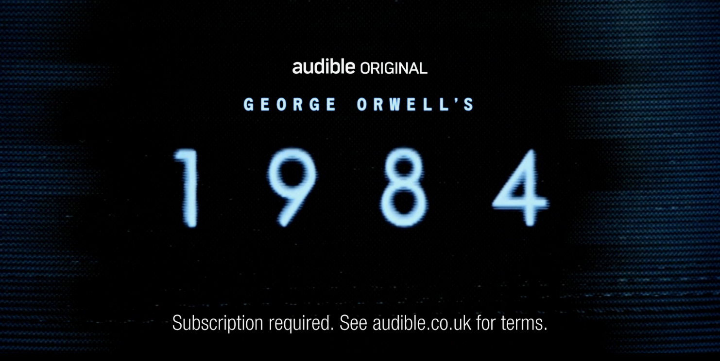
AUDIBLE
1984 Audible Original x Idents
DCM Awards Nominee
Best Creative Use of Cinema
SECTOR | TARGET AUDIENCE | PACKAGE | MEDIA AGENCY | COPY LENGTH
Technology | ABC1 Adults | Silver Spot & Idents | Wavemaker | 30”
BACKGROUND
In early 2024, Audible aimed to launch its biggest and most ambitious ever ‘Audible Original’ - a new adaptation of Orwell’s classic 1984 packed with A-List talent including Andrew Garfield, Cynthia Erivo, Andrew Scott, and Tom Hardy. With an aim to create a launch big enough to garner attraction, Audible also had a more tangible objective of compelling people to take out a free trial subscription.
Cinema, as the home of the biggest names in acting and entertainment, was an obvious fit to launch the teaser phase of the campaign but Audible wanted to maximise the impact of sound to enhance the storytelling and build tension.
PLAN
Looking to disrupt & engage, Audible collaborated with DCM Studios to bring the dystopia of 1984 through to 2024, creating bespoke ‘glitching’ idents that would open and close the ad reel to grab the audience’s attention and create intrigue.
Wanting to match the immersive and premium audio content with the right film, the campaign ran the full 60” trailer in the Silver Spot in Dune: Part II with cinema audiences the first globally to see the ad.
RESULTS
Improved Interest - The campaign generated significant buzz, capturing the attention of industry press, Orwell fans, and Reddit communities – who wrote that the cinema ad “made me want to carry on watching the ad break to see what it was for”.
Translated into success - The innovative ‘glitch’ ads intrigued audiences, driving engagement and anticipation, ultimately leading to 1984 becoming April’s global chart-topper.
Source: Audible x DCM Awards Entry 2024

