Slide 1
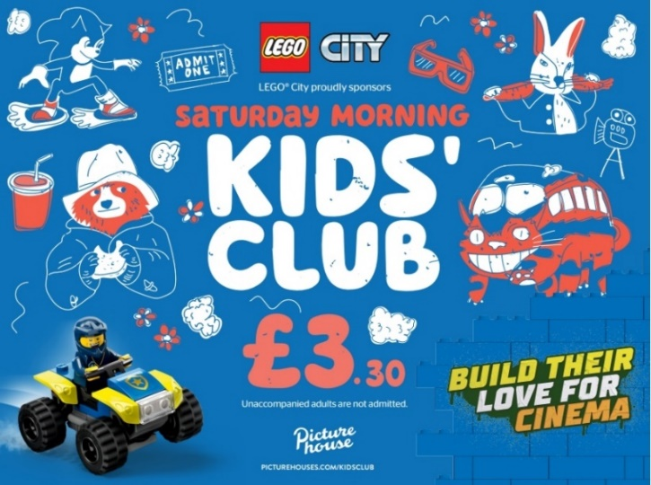
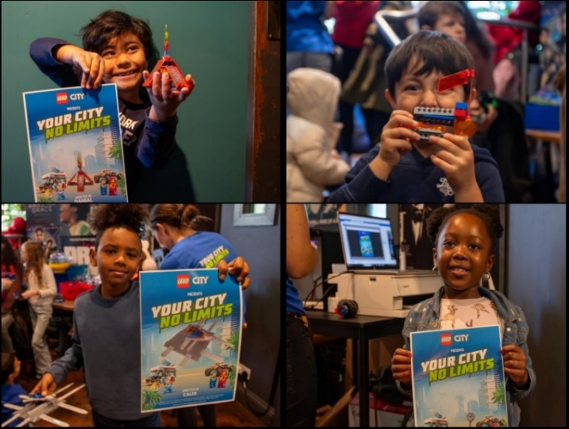
LEGO
DCM Awards Winner
Best Use of Cinema (Small)
LEGO City & Picturehouse Kids’ Club - Build Their Love For Cinema
SECTOR | TARGET AUDIENCE | PACKAGE | MEDIA AGENCY | COPY LENGTH
Retail | Boys 3-5 | Partnership & Idents | Initiative | 30”, 10”
BACKGROUND
LEGO were faced with a challenge – interest among young boys had begun to drop and sales were slowing. To addressing these issues, LEGO wanted to re-establish strong brand loyalty with kids that would last the test of time. Looking to build awareness, drive engagement and convert interest into sales LEGO needed an immersive environment to succeed.
While parents are typically the decision-makers when it comes to purchasing toys for their kids, they often need inspiration amidst an overwhelming sea of options. LEGO saw the opportunity that the ‘family cinema trip’ could offer them – reaching parents and kids together and being able to harness the immersion of cinema to introduce them to a whole new world of play with LEGO City, coining the ‘Build Their Love for Cinema’ proposition.
PLAN
LEGO partnered with Picturehouse Cinemas and their Saturday Kids' Club, featuring hands-on LEGO City activations across nine Picturehouse cinemas – allowing kids to play with LEGO bricks for free before the screenings, take home samples, and create their own movie posters.
In addition to the activation, LEGO ran a 30” ad in Picturehouse’s Family AGP, in addition to a bespoke 10” Kids Club ident that drove awareness of the partnership and further cemented the brand at the heart of family trips to the cinema. LEGO also had a huge presence across the Picturehouse website boosting awareness of the partnership and the activations taking place at their local cinemas.
LEGO also ran 8 monthly competitions giving fans the chance to win LEGO City bundles, to further drive product desirability and trial among families.
RESULTS
In summary, the "Build Their Love for Cinema" campaign revitalised LEGO City, driving brand love and engagement among young audiences and their parents.
AWARENESS
Increased +6% YOY to almost 70%, exceeding expectations.
SUCCESSFUL ACTIVATION
The LEGO City activations were also a success for Picturehouse Cinemas, with those cinemas hosting the activations seeing a +74% increase in Kids Club admissions.
INCREASED PRODUCT SHARE
The active consumer share among boys aged 3-5 grew by +18%, surpassing LEGO’s goal and showcasing the effectiveness of the high impact and hands-on media strategy.
Source: Lego x DCM Awards Entry 2024

