Slide 1
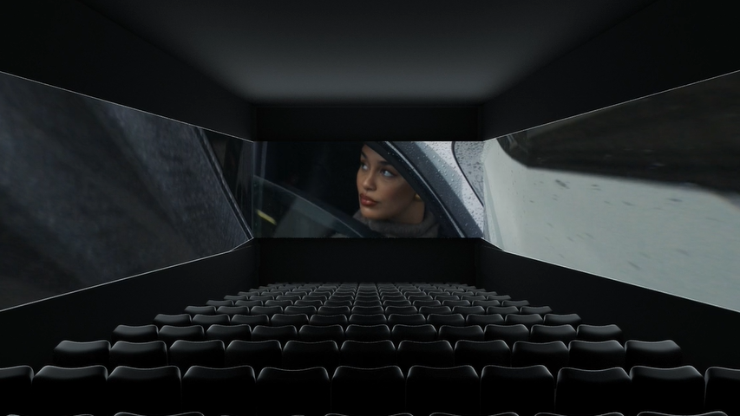
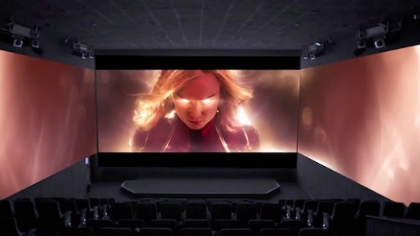
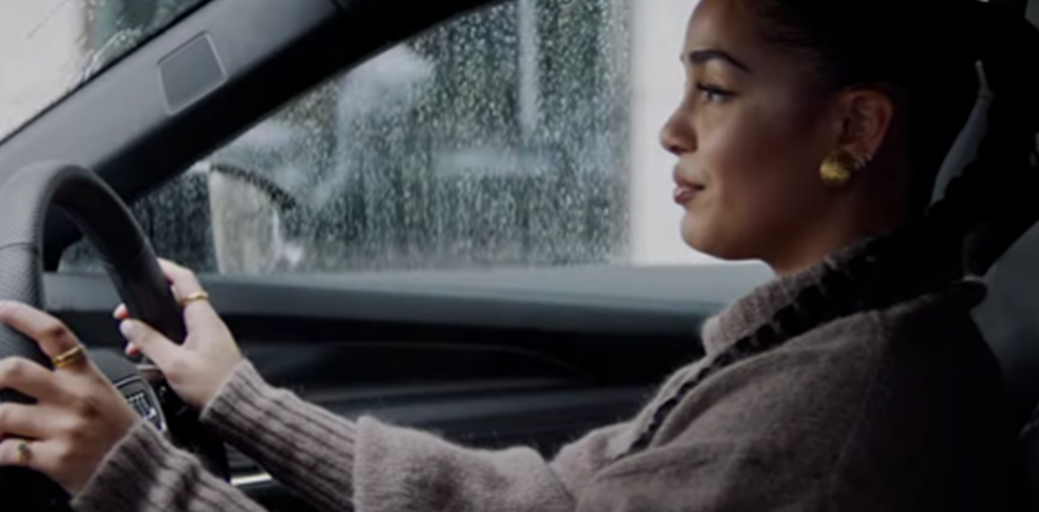
AUDI
Sector | Target Audience | Package | Media Agency | Copy Length
Automotive | ABC1 Adults | Screen X | PHD | 60”
Life is a Work in Progress
Background & Plan
Audi has consistently used cinema because of its ability to reach the target affluent audience in a high-attention environment that can also help re-affirm the brand’s premium and prestige perceptions.
In 2023, as well as continuing to invest in premium positions across cherry-picked relevant titles, Audi wanted to test out the incremental impact that the ad could have if converted into full Screen X format.
The cinema campaign was running alongside a wider AV campaign that included BVOD, Social, Online, and Outdoor.
DCM commissioned research to help Audi understand the differences between those unexposed to the ad in cinema (Control), those who saw the standard ad of in the Wonka Gold Spot (Test 1) and those who saw the Screen X version of the ad in Screen X showings of The Marvels (Test 2).
Results
Audi saw the benefit of using an immersive format to maximise attention and impact of its creative within cinema, seeing significant uplifts across key brand and engagement metrics.
Awareness More than 2 in 3 Test Screen X respondents were aware of Audi as an electric car brand (+24% significant uplift from control)
Recall 75% of Screen X cinemagoers were able to recall having seen the Audi activity before, a 9% uplift from those just exposed to the ad in the normal screen
Associations Associations with ‘Life is a Work in Progress’ improved by +63% for the Screen X test group.
Perceptions Agreement with the key perception that ‘Audi is a prestige brand’ saw significant improvement (+15%) after exposure to the Screen X ad, suggesting that using this format was beneficial in driving quality and stature perceptions for Audi by standing out from other advertisers in the reel (who hadn’t utilised the Screen X format)
Appeal of Screen X 56% agreed that seeing the bespoke Screen X ad made it more impactful, easier to remember, and/or enjoyable.
Source: DCM / Audi. Conducted by; Differentology, Nov 2023.
Results base: 16+, Uplifts are control (unexposed to ad) vs test 1 (exposed to gold spot ad) vs test 2 (exposed to Screen X ad)

