Slide 1
MINECRAFT
Be there or be square!
RELEASE DATE | EST. INDUSTRY ADMISSIONS | GENRE | HFSS BRANDS | ALCOHOL/GAMBLING BRANDS
4 April 2025 | 3m | Adventure / Comedy | Yes | No
SYNOPSIS
A mysterious portal pulls four misfits into the Overworld, a bizarre, cubic wonderland that thrives on imagination. To get back home, they'll have to master the terrain while embarking on a magical quest with an unexpected crafter named Steve.
CAST
Jason Momoa, Jack Black, Emma Myers, Danielle Brooks, Jennifer Coolidge
THE DCM TAKE
Since its first teaser trailer release, Minecraft has drawn significant attention from fans on social media, eager to see how the game's blocky visuals and open-world charm will translate to the big screen. With it’s cast including popular actors like Jason Momoa and Jack Black involved, the film is expected to blend humour with the game’s pixelated charm, using CGI to bring its unique visuals to life. As video game adaptations rise in popularity, films like The Super Mario Bros. Movie (2023), Sonic the Hedgehog (2020), and Five Nights at Freddy’s (2023) have paved the way for Minecraft's fresh take on the genre.
Strategically timed to release before the Easter school holidays, Minecraft will be an efficient way for brands to reach younger audiences and families.
 | Adults (16+) | HP+CH | 16-34 Adults | 16-34 Men | Children 7-15
REACH | 4% | 6% | 7% | 7% | 11%
IMPACTS | 2.2m | 1m | 1m | 608k | 766k
TVRS | 5 | 7 | 7 | 8 | 12
Source: Based on industry admissions and comparative film profile

Slide 2
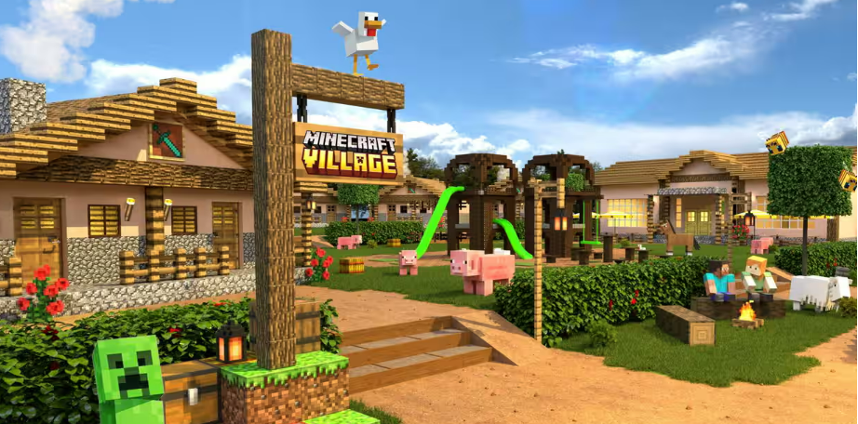
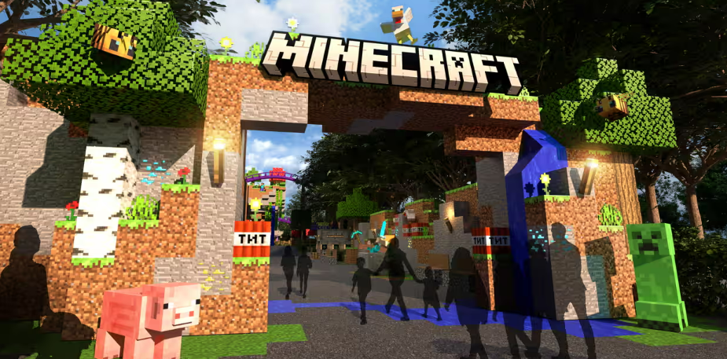
Minecraft is the bestselling video game of all time
With 140 million players each month, more than 1.3tn videos posted by game players on YouTube, Minecraft continues to be the most successful video game.

Slide 3
GAME ADAPTATIONS have been a RISING success
In recent years, video game film adaptations have become a growing success, continuously capturing fan interest, delivering on unique visuals, and sometimes even garnering critical acclaim.
Uncharted (2022)
This film found success with fans through its dynamic action sequences, engaging storytelling, and strong performances from Tom Holland, grossing £24.3m at the UK box office.
Sonic the Hedgehog (2020, 2022, 2024)
Sonic charmed audiences with Ben Schwartz’s voice work and Jim Carrey’s lively portrayal of Dr. Robotnik, with a third instalment of the franchise releasing in December 2024.
Five Nights at Freddy’s (2023)
Recently released, it hit a nostalgic note for fans of the horror game series, with a sequel on the way…
The Super Mario Bros Movie (2023)
This animated adaptation brought Mario and friends into a fun, colourful universe that attracted families and fans of the Nintendo games. This film also resonated strongly towards 16-34 adults, delivering 16 TVRs. ​
Source: IBOE

Slide 4
reach families with Minecraft
The majority of cover for advertisers is unique, with the film forecast to deliver 7 TVRS against HP+CH and 12 against 7- 15-year-olds.
Source: CAA C+F Planner. Predicted industry admissions

Slide 5
Minecraft OFFERs STRONG EFFIENCY AND CONVERSION FOR families vs tv programming
Minecraft has a better conversion to houseperson and children than many major TV spots, so brands should utilise cinema for reaching this audience.
13% of GB population are HPCH
Sources: Adwanted Connected, top rating HP+CH shows (top episodes for each series), Apr – May
% of adult (4+) audience that are HP+CH. DCM films based on comparative profiles HP+CH against base of 16+ Individuals

Slide 6
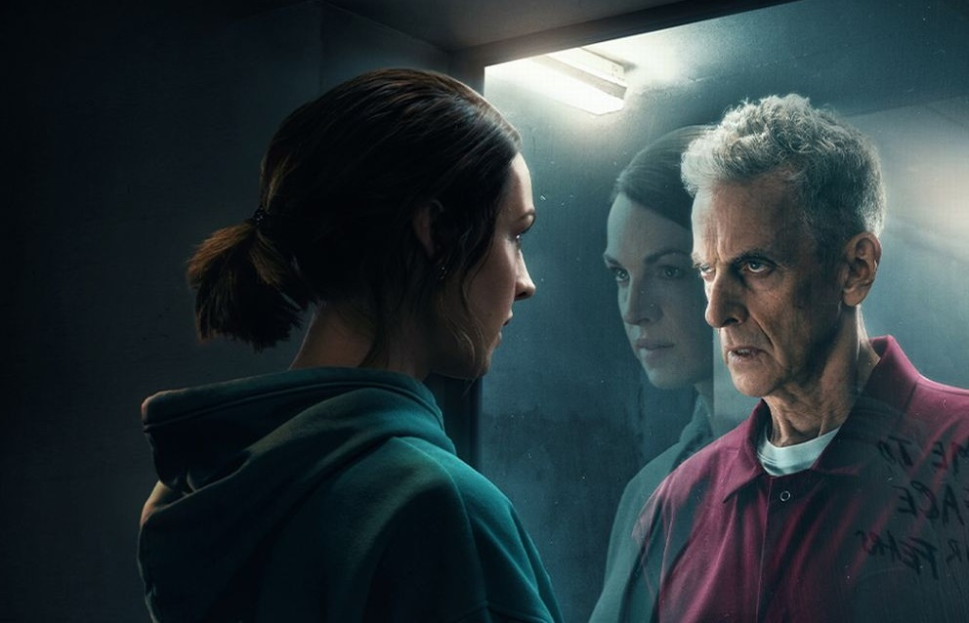
Cinema DELIVERS POSITIVE OUTCOMES FOR entertainment & leisure BRANDS
Looking at our brand lift study databank, it’s evident that cinema drives significant uplifts for your key brands metrics across the full funnel.
Meta-analysis of 17 cinema campaigns: Average uplifts seen from Control (unexposed to cinema ad) vs Test (exposed to cinema ad)
+53%
Recall
+49%
Pure Gym
Amazon Prime
Puregym aimed at expanding reach to potential customers, driving awareness, consideration to sign up and strengthen perceptions surrounding value for money and overall quality.
Knowing how cinema is beneficial in providing incremental reach to a more engaged audience, on top of an existing AV plan Puregym bought into film packs across Dec 23 – Feb 24 that would index strongly towards their target audience of 18-34s, giving them access to Wonka, Aquaman & The Lost Kingdom, Next Goal Wins and Night Swim.
Exposure to the ad in the cinema was found to significantly increase Puregym’s target audiences core brand metrics and cinema was successful in helping to significantly boost lower funnel metrics including overall conversion & consideration to join a Puregym
Prime Video worked with DCM Studios to create a high impact, disruptive launch campaign for its new psychological thriller series The Devil’s Hour.
Disrupting the cinema reel by running 3 bespoke 10” blipverts, the main 30” ad, and a ‘takeover’ of the DCM closing ident delivered prominence for the show in an already high attention environment.
This high frequency approach to cinema worked very well for Prime Video. Awareness of The Devil’s Hour show increased by +56% vs control, recall of the in-reel advertising was +25% vs. DCM benchmark and consideration to watch the show was +1-5% vs. those who hadn’t seen the cinema ads too.
Recommendation
+20%
Perceptions
Source: Differentology Cinema Effectiveness Databank (2016 – 2024). Meta-analysis consists of 17 Entertainment & Leisure campaigns. Uplifts based on relative difference between Control (unexposed to ad) vs Test (exposed to ad). Results for all respondents

Slide 7
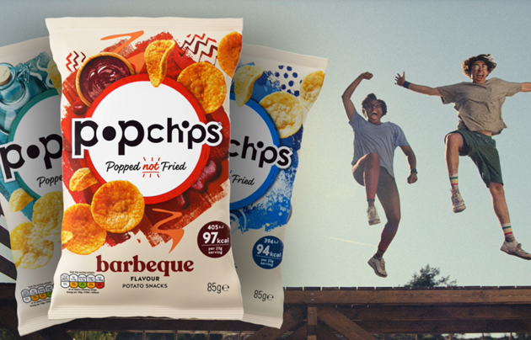
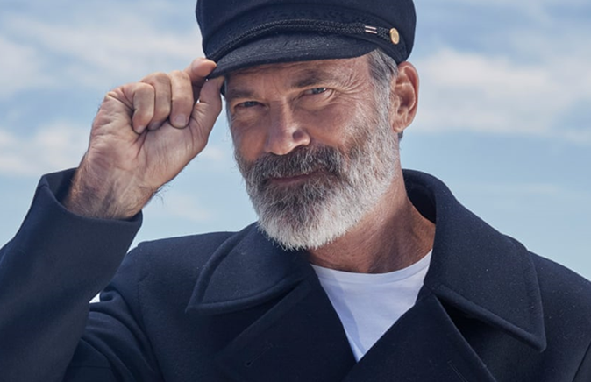
Cinema DELIVERS POSITIVE OUTCOMES FOR FMCG BRANDS
Looking at our brand lift study databank, it’s evident that cinema drives significant uplifts for your key brands metrics across the full funnel.
Meta-analysis of 11 cinema campaigns: Average uplifts seen from Control (unexposed to cinema ad) vs Test (exposed to cinema ad)
+51%
Recall
+45%
Popchips
Birds Eye
Being new to cinema, Popchips wanted to launch their brand and message across an attentive space to showcase their existing 20” TVC across a wide range of films in Q4 of 2023.
Popchips saw cinema as the perfect medium for boosting salience in a shared environment, to drive impact and recommendation vs their already established competitors. Their key objective for this campaign involved driving purchase intent across their target audience of adults who buy crisps, testing cinema's ability in driving conversion metrics
Cinema exposure significantly improved upper- and middle-funnel metrics including awareness, key perceptions, consideration and intention to purchase
Whilst already being a highly salient brand, Birds Eye wanted to reach a family demographic to promote their new product and saw the opportunity to use cinema to drive incremental reach to complement their wider AV channel mix. They reintroduced the beloved character ‘The Captain’ to engage their audiences, connect emotionally.
Aiming to leverage cinema to enhance perceptions of product quality, sustainability and brand worth, Birds Eye ran in a Family AGP from April to June.
The inclusion of cinema was successful in improving Birds Eye’s core brand metrics, with the campaign helping to drive significant uplifts across consideration, awareness and purchase intent, with further uplifts seen across the full funnel of metrics.
Impressions
+33%
Consideration
Source: Differentology Cinema Effectiveness Databank (2016 – 2024). Meta-analysis consists of 11 FMCG campaigns. Uplifts based on relative difference between Control (unexposed to ad) vs Test (exposed to ad). Results for all respondents

