Slide 1
Dc films
2022 and 2023 are big years for the DC extended universe

Slide 2
Fans of the dc films are more likely to be young, male and ABC1.
DC films should be an attractive proposition for any brands wanting to engage with a young male audience
Source: GB TGI December 2022 – Fans of DC franchise

Slide 3
The dc universe has seen a revival in recent years
Proving that DC films are just as successful as any other franchise, and arguably on the rise
Aquaman
Released in 2018, introducing Jason Momoa into the DC Universe. The film grossed £22.5m at the UK box office, becoming the 3rd most successful film from Warner Bros. Studios in 2018, exceeding Ready Player One, The Meg & Oceans 8.
Joker
2019’s American psychological thriller film that was DC’s biggest box office success so far in the UK. It reached £58m at the UK box office and grossed over $1 billion worldwide, the first R-rated film to do so and became the fourth-highest film of 2019 during its theatrical run. A musical sequel, titled Joker: Folie à Deux, is scheduled to be released in 2024
The Batman
This film was a commercial success, delivering over £40m at the UK box office and becoming the 5th highest grossing film of 2022. It received positive reviews from critics with praise for the performances, score and cinematography.
Black Adam
The film received praise towards the action sequences and cast performances. It grossed at a cume of £19.8m at the UK box office, making it the 4th most successful film at the UK box office of 2022 that was distributed by Warner Bros. Studios, coming before Don’t Worry Darling, & DC League of Super-pets.

Slide 4
2023 dc SLATE
Shazam! Fury of the Gods
17 March
The Flash
16 June
Blue Beetle
18 August
Aquaman and the Lost Kingdom
26 December
Notes:
Please note you can delete the captions on each picture if needed.

Slide 5
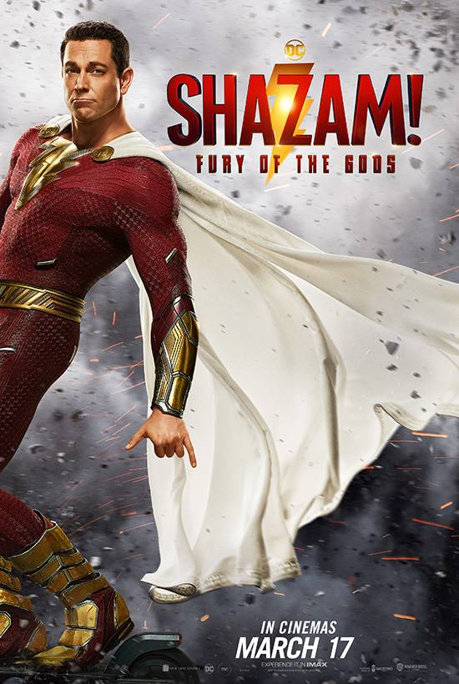
Shazam: fury of the gods
A continuation of the comedic superhero
RELEASE DATE | EST. INDUSTRY ADMISSIONS | GENRE | HFSS BRANDS | ALCOHOL/GAMBLING BRANDS
17 March | 1.5m | Action, Adventure | Yes | No
SYNOPSIS
'Shazam! Fury Of The Gods' continues the story of teenage Billy Batson who, upon reciting the magic word "Shazam!" is transformed into his adult superhero alter ego, Shazam. Shazam takes on the villainous Hespera and Kalypso, daughters of the Greek titan Atlas.
CAST
Zachary Levi, Helen Mirren, Adam Brody
THE DCM TAKE
This sequel welcomes back the comedic fun-loving superhero following the success of the original. Not only is Shazam! the DCU’s second top-rated title on Rotten Tomatoes behind only Wonder Woman, but it’s also one of the most profitable after hauling in $366 million at the global box office on a budget reported to be less than $100 million.
Shazam! grossed £13.3m at the UK box office, delivering 1.5m DCM admissions. The first trailer for the new film received an enthusiastic reception when it was first unveiled to the masses, showing that there is a lot of hype around this release, especially across young adult and family audiences.
 | Adults (16+) | 16-34 Adults | 16-34 Men | ABC1 Adults | ABC1 Men
REACH % | 2.8% | 4.3% | 5.3% | 3.3% | 3.9%
IMPACTS | 1.4m | 698k | 450k | 941k | 555k
TVRS | 2.9 | 4.6 | 5.8 | 3.5 | 4.2
Source: DCM Planner, based on industry admissions

Slide 6
SHAZAM! fury of the gods: TVR CURVE
Based on current forecasts we estimate that Shazam will deliver 5.7 16-34 Men TVRs
Source: CAA C+F Planner. Predicted industry admissions.

Slide 7
THE FLASH
DC continue a busy 2023 with their speedy superhero
RELEASE DATE | EST. INDUSTRY ADMISSIONS | GENRE | HFSS BRANDS | ALCOHOL/GAMBLING BRANDS
16 June | 2.5m | Superhero | Yes | Yes
SYNOPSIS
The Flash travels through time to prevent the murder of his mother, but unwittingly causes changes that result in the creation of a multiverse.
CAST
Ezra Miller, Ben Affleck, Michael Keaton, Sasha Calle, Michael Shannon, Temuera Morrison
THE DCM TAKE
Ezra Miller’s The Flash has been part of the DC universe for a while now, having appeared in Batman V Superman: Dawn Of Justice, and Justice League, but he finally gets his own film in 2023 and he’s got some big name tricks up his sleeve. Like Spider-Man: No Way Home, expect more mischief with the multi-verse, and both Ben Affleck and Michael Keaton are said to feature as Batman. It’s a great way to reach 16-34 men across the summer.
 | Adults (16+) | 16-34 Adults | 16-34 Men | ABC1 Adults | ABC1 Men
REACH % | 4.1% | 7.8% | 9.2% | 4.6% | 5.8%
IMPACTS | 2.2m | 1.3m | 824k | 1.3m | 853k
TVRS | 5 | 8.7 | 10.5 | 5 | 6.4
Source: DCM Planner, based on industry admissions

Slide 8
The Flash: TVR CURVE
Based on current forecasts we estimate that The Flash will deliver 10.5 16-34 Men TVRs
Source: CAA C+F Planner. Predicted industry admissions.

Slide 9
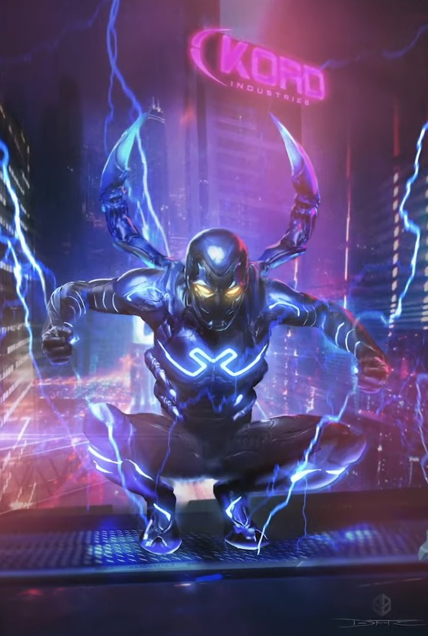
BLUE BEETLE
The 14th superhero in the DC extended universe
RELEASE DATE | EST. INDUSTRY ADMISSIONS | GENRE | HFSS BRANDS | ALCOHOL/GAMBLING BRANDS
18 August | 1.2m | Superhero | Yes | No
SYNOPSIS
A Mexican teenager finds an alien beetle that gives him superpowered armour.
CAST
Susan Sarandon, George Lopez, Xolo Maridueña
THE DCM TAKE
Although the plot is still being kept under wraps, the inclusion of Susan Sarandon as the antagonist Victoria Kord implies that they are sticking close to the comics. This film introduces Xolo Maridueña as our new superhero, who plays a young man who becomes a superhero after accidentally acquiring a powerful alien technology that allows him to manifest a weaponized exoskeleton. Initially set for an exclusive on HBO Max, Warner Bros is now focusing on bringing big DC superhero movies exclusively to theatres and so the film was switched from a VOD release to a cinema-first release worldwide. This film will provide a solid option during the summer to reach a young male audience.
 | Adults (16+) | 16-34 Adults | 16-34 Men | ABC1 Adults | ABC1 Men
REACH % | 1.9% | 3.6% | 4.6% | 2.3% | 2.7%
IMPACTS | 966k | 585k | 376k | 629k | 371k
TVRS | 2.0 | 3.8 | 4.8 | 2.4 | 2.7
Source: DCM Planner, based on industry admissions

Slide 10
Blue beetle: TVR CURVE
Based on current forecasts we estimate that Blue Beetle will deliver just under 5 16-34 Men TVRs
Source: CAA C+F Planner. Predicted industry admissions.

Slide 11
Aquaman and the lost kingdom
One of the biggest superhero films of all-time gets a sequel
RELEASE DATE | EST. INDUSTRY ADMISSIONS | GENRE | HFSS BRANDS | ALCOHOL/GAMBLING BRANDS
26 December | 2.5m | Superhero | Yes | No
SYNOPSIS
Aquaman forges an uneasy alliance with an unlikely ally in a bid to save Atlantis and the rest of the planet.
CAST
Jason Momoa, Amber Heard, Nicole Kidman, Patrick Wilson, Dolph Lundgren, Yahya Abdul-Mateen II, Temuera Morrison
THE DCM TAKE
The return of Jason Momoa as Arthur Curry, aka Aquaman is the sequel that DC fans have been waiting for. James Wan, who drove the first Aquaman to box office success, returns to direct this second instalment which sees the titular character uncover the lost Kingdom. The first Aquaman movie grossed over £22m at the UK box office and is one of DC’s most successful films worldwide. A strong title for young male audience, Aquaman delivered over 12 16-34 male TVRs and we expect the sequel to remain a highly efficient buy for this audience, providing a chance to engage them during the post-Christmas period and run deep into January too.
 | Adults (16+) | 16-34 Adults | 16-34 Men | ABC1 Adults | ABC1 Men
REACH % | 4.1% | 7.8% | 9.2% | 4.6% | 5.7%
IMPACTS | 2.2m | 1.3m | 824k | 1.3m | 855k
TVRS | 5 | 8.7 | 10.5 | 5 | 6.4
Source: DCM Planner, based on industry admissions

Slide 12
Aquaman and the lost kingdom: TVR CURVE
Based on current forecasts we estimate that Aquaman will deliver 10 16-34 Men TVRs
Source: CAA C+F Planner. Predicted industry admissions.

Slide 13
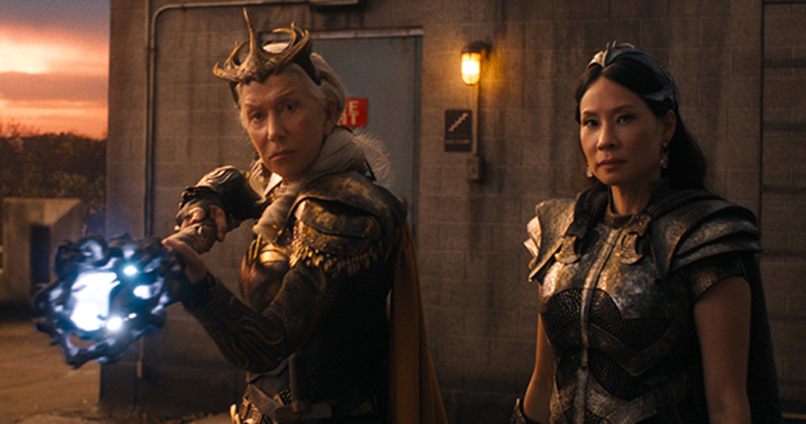
AUDIENCE SNAPSHOTS: dc FANS
Category insights
MOTORS
EVENTS
HOBBIES & INTERESTS
“I LIKE INNOVATIVE CARS”
Index: 135
BEEN TO AN EVENT AT A MAJOR VENUE/ARENA (E.G. THE O2, WEMBLEY, MEN MANCHESTER)
Index: 124
WATCH CONTENT ON SVOD SERVICES
Index: 128
WATCH SPORTS PROGRAMMES
Index: 125
INTEND TO BUY CAR IN NEXT 12 MONTHS
Index: 129
“I LIKE TO LISTEN TO NEW BANDS”
Index: 134
HAVE ACCESS TO 3+ SVOD SERVICES
Index: 151
VISIT GYM/HEALTH CLUB
Index: 143
INTEND TO BUY – NEW (NOT SECONDHAND)
Index: 113
PLAN TO GO TO A THEME PARK IN THE NEXT 12 MONTHS
Index: 141
BOUGHT TAKEAWAY FOOD ONLINE IN THE PAST 6 MONTHS
Index: 163
PLANNING TO BOOK HOLIDAY IN NEXT 12 MONTHS
Index: 119
Source: TGI GB Oct 2022, Film Franchise Fans – DC, Index vs GB average

Slide 14
THE DC AUDIENCE IS A PERFECT MATCH FOR GAMING & TECH BRANDS
DC fans: Gaming & Tech insights
GAME CONSOLE OWNERS
Index: 164
“LOVE TO BUY NEW GADGETS & APPLIANCES”
Index: 134
INTEND TO PURCHASE: LAPTOP/TABLET
Index: 144
“MY FAVE PASTTIME IS PLAYING VIDEO GAMES”
Index: 158
“TRY TO KEEP UP WITH TECH DEVELOPMENTS”
Index: 125
INTEND TO PURCHASE: SMARTPHONE
Index: 151
INTEND TO PURCHASE: GAMES CONSOLE
Index: 278
“I LIKE INNOVATIVE H/HOLD DEVICES”
Index: 127
INTEND TO PURCHASE: HOME SMART TECH (E.G SMART SPEAKERS)
Index: 198
Source: TGI GB Oct 2022, Film Franchise Fans – DC, Index vs GB average

